Slide 1
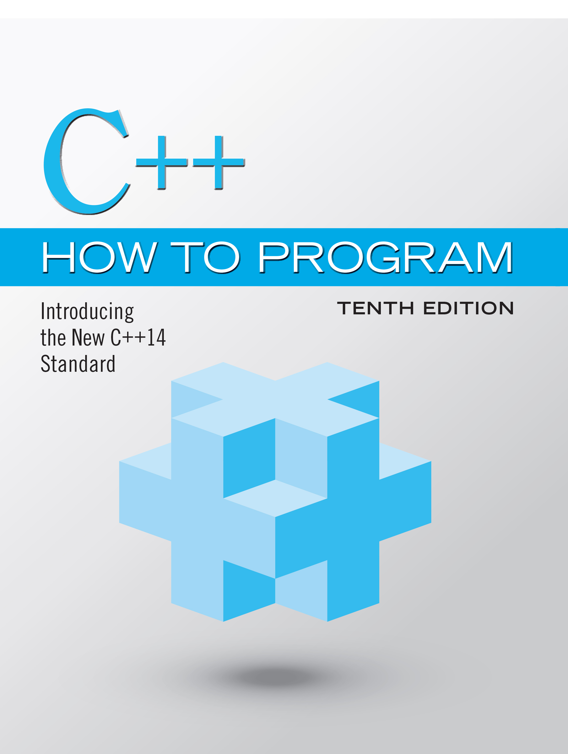
C++ How to Program: Introducing the New C++14 Standard
Tenth Edition
Chapter 7
Class Templates Array and Vector; Catching Exceptions
Copyright © 2017, 2014, 2012 Pearson Education, Inc. All Rights Reserved
Notes:
If this PowerPoint presentation contains mathematical equations, you may need to check that your computer has the following installed:
1) MathType Plugin
2) Math Player (free versions available)
3) NVDA Reader (free versions available)

Slide 2
Learning Objectives (1 of 2)
Use C++ Standard Library class template array—a fixed-size collection of related data items.
Declare arrays, initialize arrays and refer to the elements of arrays.
Use arrays to store, sort and search lists and tables of values.
Use the range-based for statement.
Pass arrays to functions.
Use C++ Standard Library function sort to arrange array elements in ascending order.

Slide 3
Learning Objectives (2 of 2)
Use C++ Standard Library function binary_search to locate an element in a sorted array.
Declare and manipulate multidimensional arrays.
Use one- and two-dimensional arrays to build a real-world GradeBook class.
Use C++ Standard Library class template vector—a variable-size collection of related data items.

Slide 4
Outline (1 of 3)
7.1 Introduction
7.2 arrays
7.3 Declaring arrays
7.4 Examples Using arrays
7.4.1 Declaring an array and Using a Loop to Initialize the array’s Elements
7.4.2 Initializing an array in a Declaration with an Initializer List
7.4.3 Specifying an array’s Size with a Constant Variable and Setting array Elements with Calculations
7.4.4 Summing the Elements of an array
7.4.5 Using a Bar Chart to Display array Data Graphically

Slide 5
Outline (2 of 3)
7.4.6 Using the Elements of an array as Counters
7.4.7 Using arrays to Summarize Survey Results
7.4.8 Static Local arrays and Automatic Local arrays
7.5 Range-Based for Statement
7.6 Case Study: Class GradeBook Using an array to Store Grades
7.7 Sorting and Searching arrays
7.7.1 Sorting
7.7.2 Searching
7.7.3 Demonstrating Functions sort and binary_search

Slide 6
Outline (3 of 3)
7.8 Multidimensional arrays
7.9 Case Study: Class GradeBook Using a Two-Dimensional array
7.10 Introduction to C++ Standard Library Class Template vector
7.11 Wrap-Up

Slide 7
7.1 Introduction
This chapter introduces the topic of data structures—collections of related data items.
We discuss arrays which are fixed-size collections consisting of data items of the same type, and vectors which are collections (also of data items of the same type) that can grow and shrink dynamically at execution time.
Both array and vector are C++ standard library class templates.
We present examples that demonstrate several common array manipulations and introduce exception handling.

Slide 8
7.2 Arrays (1 of 2)
An array is a contiguous group of memory locations that all have the same type.
To refer to a particular location or element in the array, specify the name of the array and the position number of the particular element.
Figure 7.1 shows an integer array called c.
12 elements.
The position number is more formally called a subscript or index (this number specifies the number of elements from the beginning of the array).

Slide 9
7.2 Arrays (2 of 2)
The first element in every array has subscript 0 (zero) and is sometimes called the zeroth element.
The highest subscript in array c is 11, which is 1 less than the number of elements in the array (12).
A subscript must be an integer or integer expression (using any integral type).

Slide 10
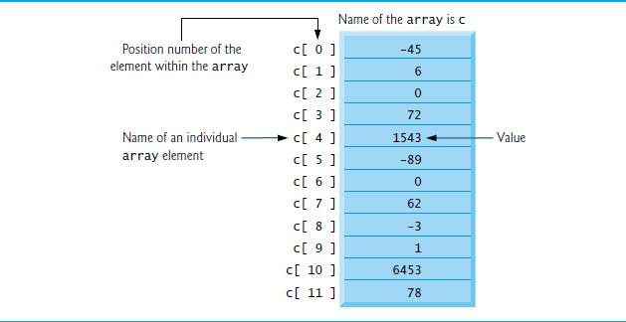
Figure 7.1 Array of 12 Elements

Slide 11
Common Programming Error 7.1
Note the difference between the “seventh element of the array” and “array element 7.” Subscripts begin at 0, so the “seventh element of the array” has the subscript 6, while “array element 7” has the subscript 7 and is actually the eighth element of the array. This distinction is a frequent source of off-by-one errors. To avoid such errors, we refer to specific array elements explicitly by their array name and subscript number (e.g., c[6] or c[7]).

Slide 12
Figure 7.2 Precedence and Associativity of the Operators Introduced to This Point (1 of 2)
Operators | Associativity | Type
colon colon left parenthesis right parenthesis | left to right [See caution in Figure 2.10 regarding grouping parentheses.] | primary
left parenthesis right parenthesis left bracket right bracket plus plus minus minus static_cast<type>(operand) | left to right | postfix
++ -- + - ! | right to left | unary (prefix)
asterisk forward slash percent sign | left to right | multiplicative
+ - | left to right | additive
left angle bracket left angle bracket right angle bracket right angle bracket | left to right | insertion/extraction
less than sign less than sign equals greater than sign greater than sign equals | left to right | relational

Slide 13
Figure 7.2 Precedence and Associativity of the Operators Introduced to This Point (2 of 2)
Operators | Associativity | Type
== != | left to right | equality
&& | left to right | logical AND
|| | left to right | logical OR
? : | right to left | conditional
equals plus equals minus equals asterisk equals forward slash equals percent sign equals | right to left | assignment
, | left to right | comma

Slide 14
7.3 Declaring Arrays
arrays occupy space in memory.
To specify the type of the elements and the number of elements required by an array use a declaration of the form:
array< type, arraySize > arrayName;
The notation <type, arraySize> indicates that array is a class template.
The compiler reserves the appropriate amount of memory based on the type of the elements and the arraySize.
arrays can be declared to contain values of most data types.

Slide 15
7.4 Examples Using Arrays
The following examples demonstrate how to declare arrays, how to initialize arrays and how to perform common array manipulations.

Slide 16
7.4.1 Declaring an Array and Using a Loop to Initialize the Array’s Elements
The program in Figure 7.3 declares five-element integer array n (line 10).
size_t represents an unsigned integral type.
This type is recommended for any variable that represents an array’s size or an array’s subscripts. Type size_t is defined in the std namespace and is in header <cstddef>, which is included by various other headers.
If you attempt to compile a program that uses type size_t and receive errors indicating that it’s not defined, simply include <cstddef> in your program.

Slide 17
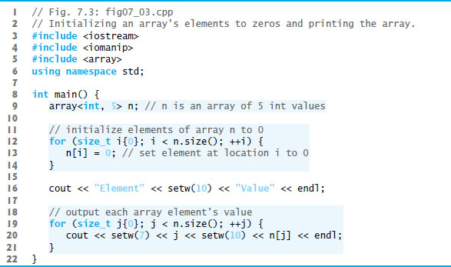
Figure 7.3: Initializing an Array’s Elements to Zeros and Printing the Array (1 of 2)

Slide 18
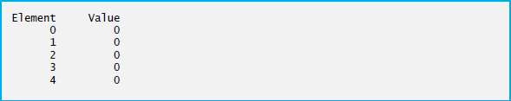
Figure 7.3: Initializing an Array’s Elements to Zeros and Printing the Array (2 of 2)

Slide 19
7.4.2 Initializing an Array in a Declaration with an Initializer List
The elements of an array also can be initialized in the array declaration by following the array name with an equals sign and a brace-delimited comma-separated list of initializers.
The program in Figure 7.4 uses an initializer list to initialize an integer array with five values (line 11) and prints the array in tabular format (lines 13–17).
If there are fewer initializers than elements in the array, the remaining array elements are initialized to zero.
If there are more, a compilation error occurs.

Slide 20
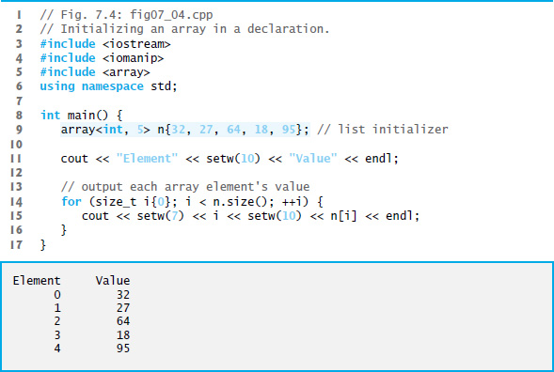
Figure 7.4: Initializing an Array in a Declaration

Slide 21
7.4.3 Specifying an Array’s Size with a Constant Variable and Setting Array Elements with Calculations
Figure 7.5 sets the elements of a 5-element array values to the even integers 2, 4, 6, 8 and 10 and prints the array in tabular format.
Line 10 uses the const qualifier to declare a constant variable arraySize with the value 5.
A constant variable that’s used to specify array’s size must be initialized with a constant expression when it’s declared and cannot be modified thereafter.
Constant variables are also called named constants or read-only variables.

Slide 22
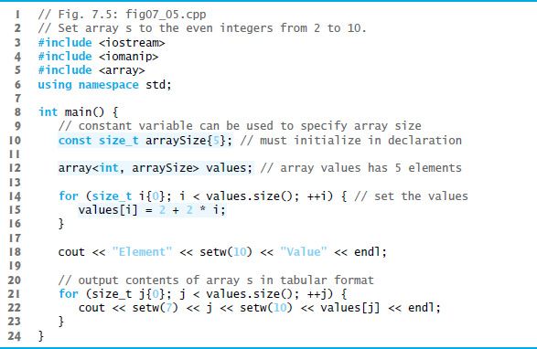
Figure 7.5 Set Array s to the Even Integers from 2 to 10 (1 of 2)

Slide 23
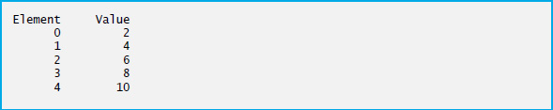
Figure 7.5 Set Array s to the Even Integers from 2 to 10 (2 of 2)

Slide 24
Common Programming Error 7.2
Not initializing a constant variable when it’s declared is a compilation error.

Slide 25
Common Programming Error 7.3
Assigning a value to a constant variable in a separate statement from its declaration is a compilation error.

Slide 26
Good Programming Practice 7.1
Defining the size of an array as a constant variable instead of a literal constant makes programs clearer and easier to update. This technique eliminates so-called magic numbers—numeric values that are not explained. Using a constant variable allows you to provide a name for a literal constant and can help explain the purpose of the value in the program.

Slide 27
7.4.4 Summing the Elements of an Array
Often, the elements of an array represent a series of values to be used in a calculation.
Figure 7.6 sums the values contained in the four-element integer array a.

Slide 28
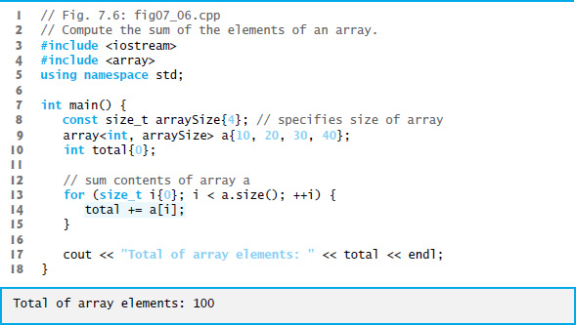
Figure 7.6 Compute the Sum of the Elements of an Array

Slide 29
7.4.5 Using Bar Charts to Display Array Data Graphically
Many programs present data to users graphically.
One simple way to display numeric data graphically is with a bar chart that shows each numeric value as a bar of asterisks (*).
Figure 7.7 stores data in an array of 11 elements, each corresponding to a grade category.

Slide 30
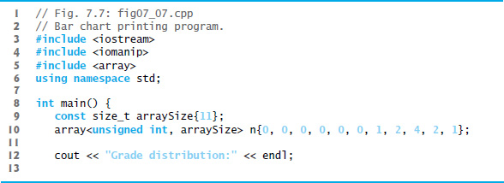
Figure 7.7 Bar Chart Printing Program (1 of 3)

Slide 31
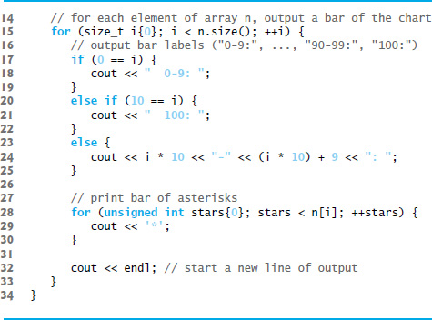
Figure 7.7 Bar Chart Printing Program (2 of 3)

Slide 32
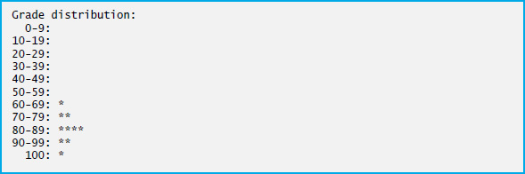
Figure 7.7 Bar Chart Printing Program (3 of 3)

Slide 33
7.4.6 Using the Elements of an Array as Counters
Sometimes, programs use counter variables to summarize data, such as the results of a survey.
In Figure 6.9, we used separate counters in our die-rolling program to track the number of occurrences of each side of a die as the program rolled the die 60,000,000 times.
An array version of this program is shown in Figure 7.8.
This version also uses the new C++ 11 random-number generation capabilities that were introduced in Section 6.9.
The single statement in line 21 of this program replaces the switch statement in Figure 6.9.

Slide 34
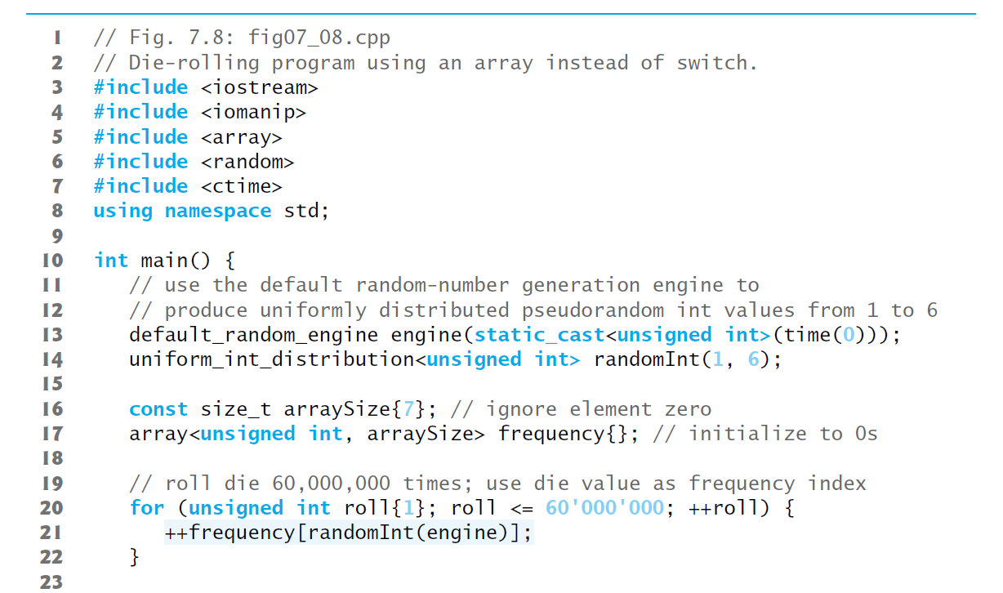
Figure 7.8 Die-Rolling Program Using an Array Instead of Switch (1 of 2)

Slide 35
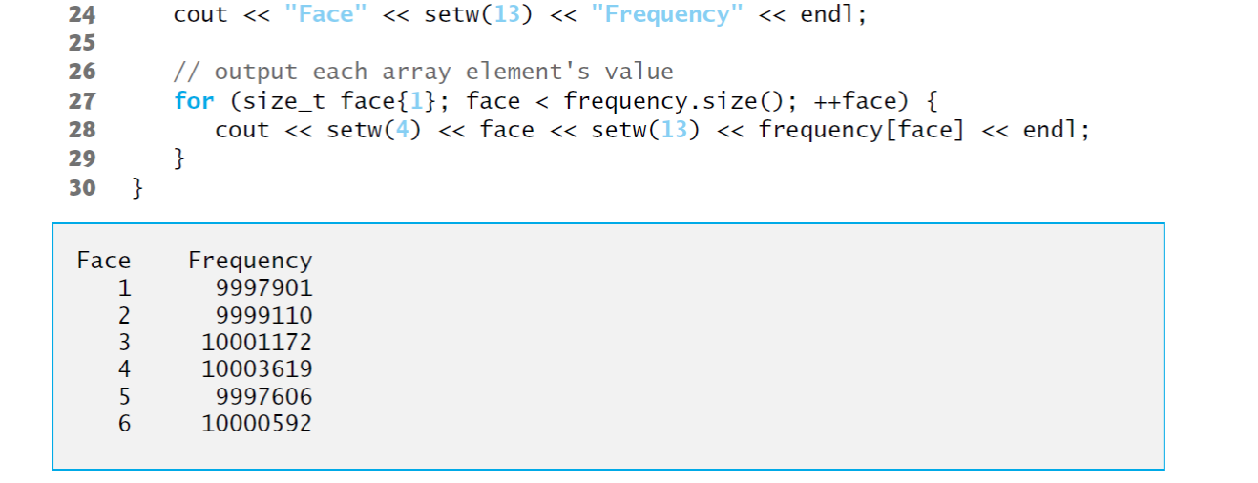
Figure 7.8 Die-Rolling Program Using an Array Instead of Switch (2 of 2)

Slide 36
7.4.7 Using Arrays to Summarize Survey Results (1 of 2)
Figure 7.9 uses arrays to summarize the results of data collected in a survey.
Consider the following problem statement:
Twenty students were asked to rate on a scale of 1 to 5 the quality of the food in the student cafeteria, with 1 being “awful” and 5 being “excellent.” Place the 20 responses in an integer array and determine the frequency of each rating.
C++ provides no automatic array bounds checking to prevent you from referring to an element that does not exist.
Thus, an executing program can “walk off” either end of an array without warning.
Class templates array and vector each have an at function that performs bounds checking for you.

Slide 37
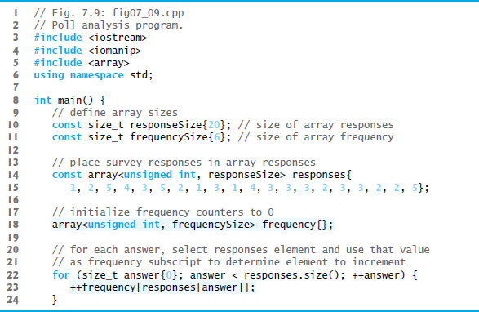
Figure 7.9 Poll Analysis Program (1 of 2)

Slide 38
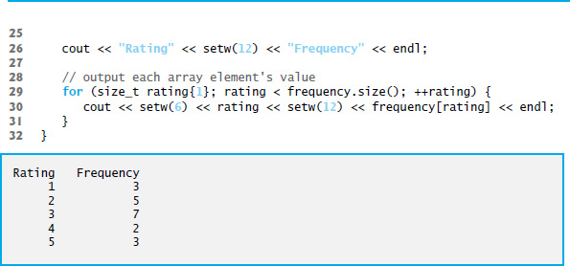
Figure 7.9 Poll Analysis Program (2 of 2)

Slide 39
7.4.7 Using Arrays to Summarize Survey Results (2 of 2)
It’s important to ensure that every subscript you use to access an array element is within the array’s bounds—that is, greater than or equal to 0 and less than the number of array elements.
Allowing programs to read from or write to array elements outside the bounds of arrays are common security flaws.
Reading from out-of-bounds array elements can cause a program to crash or even appear to execute correctly while using bad data.
Writing to an out-of-bounds element (known as a buffer overflow) can corrupt a program’s data in memory, crash a program and allow attackers to exploit the system and execute their own code.

Slide 40
Common Programming Error 7.4
Referring to an element outside the array bounds is an execution-time logic error, not a syntax error.

Slide 41
Error-Prevention Tip 7.1
When looping through an array, the index should never go below 0 and should always be less than the total number of array elements (one less than the size of the array). Make sure that the loop-termination condition prevents accessing elements outside this range. In Section 7.5, you’ll learn about the range-based for statement, which can help prevent accessing elements outside an array’s (or other container’s) bounds.

Slide 42
7.4.8 Static Local Arrays and Automatic Local Arrays
A program initializes static local arrays when their declarations are first encountered.
If a static array is not initialized explicitly by you, each element of that array is initialized to zero by the compiler when the array is created.
Local variables are sometimes called automatic variables because they’re automatically destroyed when the function finishes executing

Slide 43
Performance Tip 7.1
We can apply static to a local array declaration so that it’s not created and initialized each time the program calls the function and is not destroyed each time the function terminates. This can improve performance, especially when using large arrays.

Slide 44
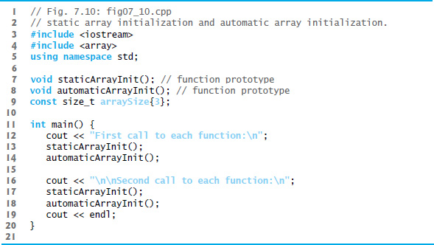
Figure 7.10 Static Array Initialization and Automatic Array Initialization (1 of 4)

Slide 45
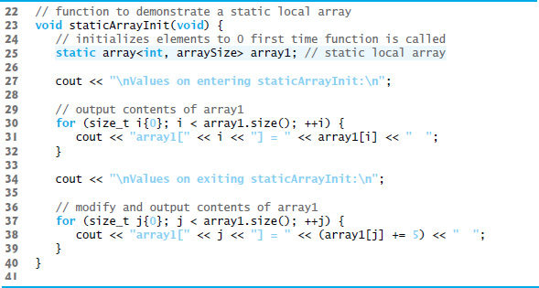
Figure 7.10 Static Array Initialization and Automatic Array Initialization (2 of 4)

Slide 46
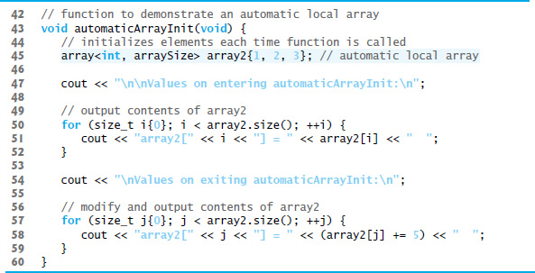
Figure 7.10 Static Array Initialization and Automatic Array Initialization (3 of 4)

Slide 47
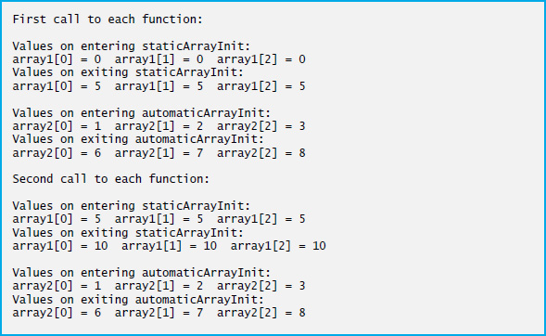
Figure 7.10 Static Array Initialization and Automatic Array Initialization (4 of 4)

Slide 48
7.5 Range-Based for Statement (1 of 4)
It’s common to process all the elements of an array.
The C++ 11 range-based for statement allows you to do this without using a counter, thus avoiding the possibility of “stepping outside” the array and eliminating the need for you to implement your own bounds checking.
Figure 7.11 uses the range-based for to display an array’s contents and to multiply each of the array’s element values by 2.

Slide 49
Error-Prevention Tip 7.2
When processing all elements of an array, if you don’t need access to an array element’s subscript, use the range-based for statement.

Slide 50
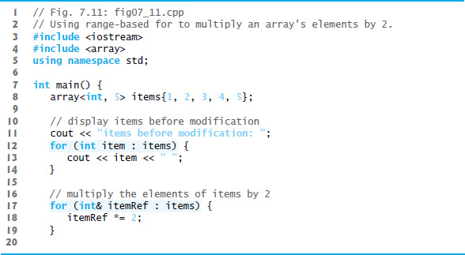
Figure 7.11 Using Range-Based for to Multiply an Array’s Elements by 2 (1 of 2)

Slide 51
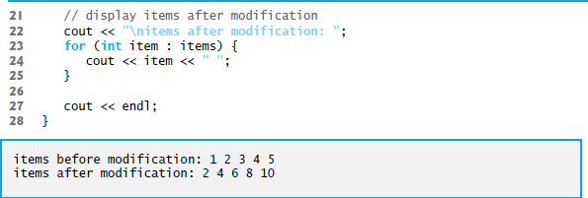
Figure 7.11 Using Range-Based for to Multiply an Array’s Elements by 2 (2 of 2)

Slide 52
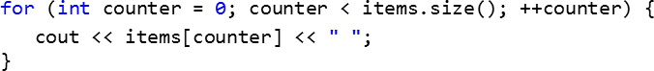
7.5 Range-Based for Statement (2 of 4)
Using the Range-Based for to Display an array’s Contents
The range-based for statement simplifies the code for iterating through an array.
Line 12 can be read as “for each iteration, assign the next element of items to int variable item, then execute the following statement.”
Lines 12–14 are equivalent to the following counter-controlled iteration:

Slide 53
7.5 Range-Based for Statement (3 of 4)
Using the Range-Based for to Modify an array’s Contents
Lines 17–19 use a range-based for statement to multiply each element of items by 2.
In line 17, the range variable declaration indicates that itemRef is an int reference (&).
We use an int reference because items contains int values and we want to modify each element’s value—because itemRef is declared as a reference, any change you make to itemRef changes the corresponding element value in the array.

Slide 54
7.5 Range-Based for Statement (4 of 4)
Using an Element’s Subscript
The range-based for statement can be used in place of the counter-controlled for statement whenever code looping through an array does not require access to the element’s subscript.
However, if a program must use subscripts for some reason other than simply to loop through an array (e.g., to print a subscript number next to each array element value, as in the examples early in this chapter), you should use the counter-controlled for statement.

Slide 55
7.6 Case Study: Class GradeBook Using an Array to Store Grades (1 of 3)
Case study on developing a GradeBook class that instructors can use to maintain students’ grades on an exam and display a grade report that includes the grades, class average, lowest grade, highest grade and a grade distribution bar chart.
This version stores the grades for one exam in a one-dimensional array.
In Section 7.9, we present a version that uses a two-dimensional array to store students’ grades for several exams.

Slide 56
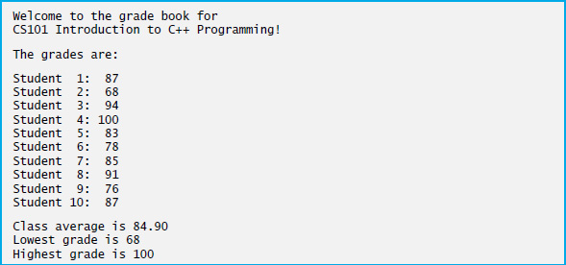
Figure 7.12 Output of the GradeBook Example That Stores Grades in an Array (1 of 2)

Slide 57
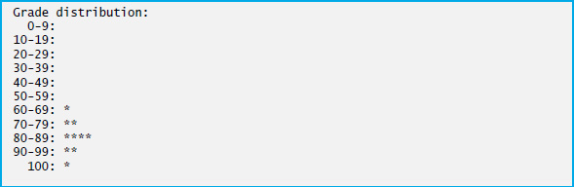
Figure 7.12 Output of the GradeBook Example That Stores Grades in an Array (2 of 2)

Slide 58
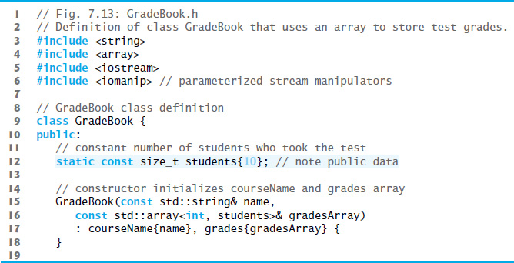
Figure 7.13 Definition of Class GradeBook That Uses an Array to Store Test Grades (1 of 8)

Slide 59
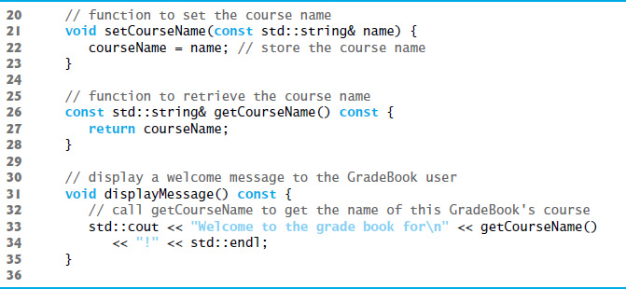
Figure 7.13 Definition of Class GradeBook That Uses an Array to Store Test Grades (2 of 8)

Slide 60
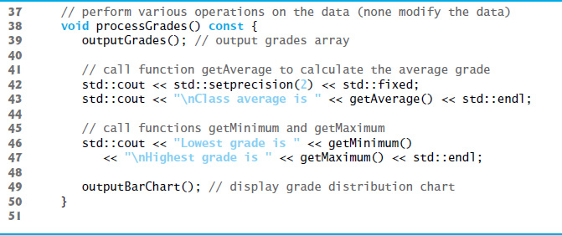
Figure 7.13 Definition of Class GradeBook That Uses an Array to Store Test Grades (3 of 9)

Slide 61
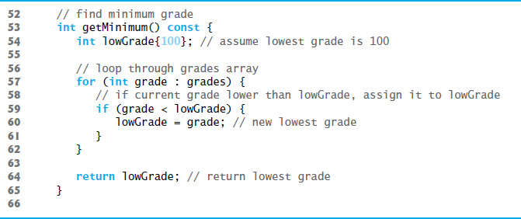
Figure 7.13 Definition of Class GradeBook That Uses an Array to Store Test Grades (3 of 8)

Slide 62
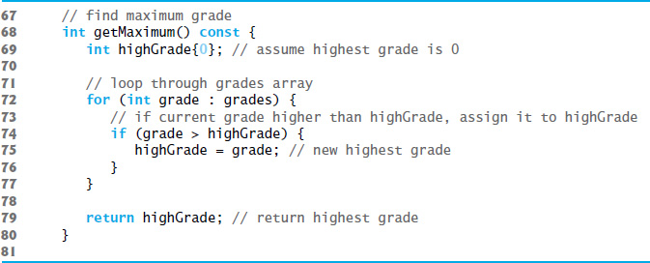
Figure 7.13 Definition of Class GradeBook That Uses an Array to Store Test Grades (4 of 8)

Slide 63
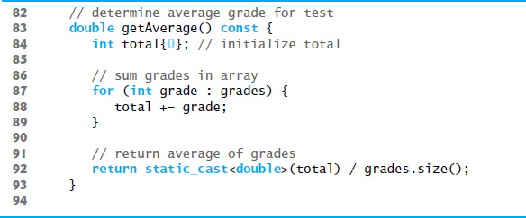
Figure 7.13 Definition of Class GradeBook That Uses an Array to Store Test Grades (5 of 8)

Slide 64
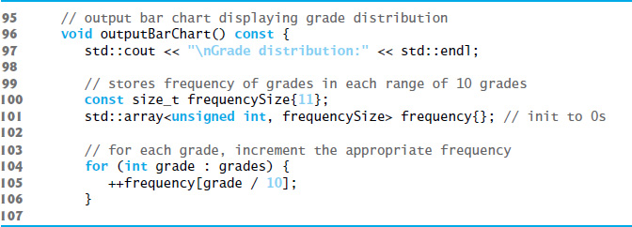
Figure 7.13 Definition of Class GradeBook That Uses an Array to Store Test Grades (6 of 8)

Slide 65
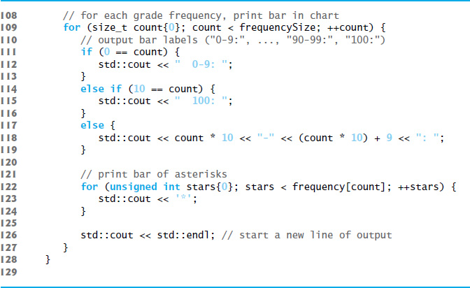
Figure 7.13 Definition of Class GradeBook That Uses an Array to Store Test Grades (7 of 8)

Slide 66
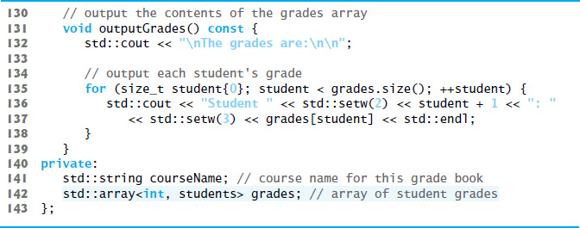
Figure 7.13 Definition of Class GradeBook That Uses an Array to Store Test Grades (8 of 8)

Slide 67
7.6 Case Study: Class GradeBook Using an Array to Store Grades (2 of 3)
The size of the array is specified as a public static const data member students.
public so that it’s accessible to the clients of the class.
const so that this data member is constant.
static so that the data member is shared by all objects of the class
There are variables for which each object of a class does not have a separate copy.
That’s the case with static data members, which are also known as class variables.
When objects of a class containing static data members are created, all the objects share one copy of the class’s static data members.

Slide 68
7.6 Case Study: Class GradeBook Using an Array to Store Grades (3 of 3)
A static data member can be accessed within the class definition and the member-function definitions like any other data member.
A public static data member can also be accessed outside of the class, even when no objects of the class exist, using the class name followed by the binary scope resolution operator (::) and the name of the data member.

Slide 69
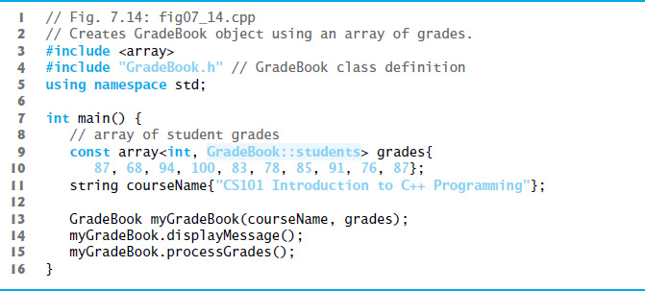
Figure 7.14 Creates a GradeBook Object’ Using an Array of Grades, Then Invokes Member Function ProcessGrades to Analyze Them

Slide 70
7.7 Sorting and Searching Arrays (1 of 2)
In this section, we use the built-in C++ Standard Library sort function to arrange the elements in an array into ascending order and the built-in binary_search function to determine whether a value is in the array.

Slide 71
7.7.1 Sorting
Sorting data—placing it into ascending or descending order—is one of the most important computing applications.

Slide 72
7.7.2 Searching (1 of 2)
Often it may be necessary to determine whether an array contains a value that matches a certain key value.
This is called searching.

Slide 73
7.7.2 Searching (2 of 2)
Figure 7.15 begins by creating an unsorted array of strings and displaying the contents of the array.
Line 21 uses C++ Standard Library function sort to sort the elements of the array colors into ascending order.
Lines 25–276 display the contents of the sorted array.

Slide 74
7.7 Sorting and Searching Arrays (2 of 2)
Lines 30 and 354 demonstrate use binary_search to determine whether a value is in the array.
The sequence of values must be sorted in ascending order first—binary_search does not verify this for you.
The function’s first two arguments represent the range of elements to search and the third is the search key—the value to locate in the array.
The function returns a bool indicating whether the value was found.

Slide 75
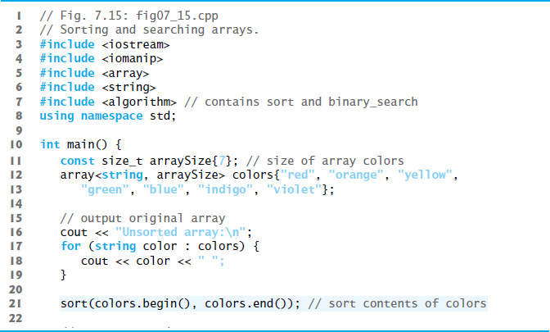
Figure 7.15 Sorting and Searching Arrays (1 of 2)

Slide 76
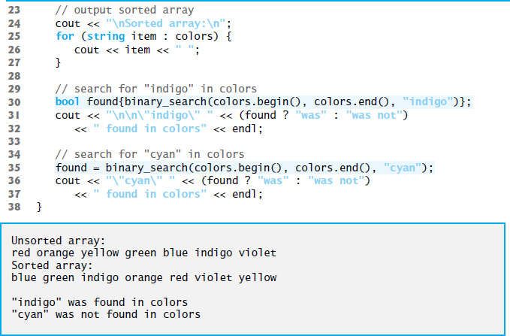
Figure 7.15 Sorting and Searching Arrays (2 of 2)

Slide 77
7.8 Multidimensional Arrays (1 of 4)
You can use arrays with two dimensions (i.e., subscripts) to represent tables of values consisting of information arranged in rows and columns.
To identify a particular table element, we must specify two subscripts—by convention, the first identifies the element’s row and the second identifies the element’s column.
Often called two-dimensional arrays or 2-D arrays.
Arrays with two or more dimensions are known as multidimensional arrays.
Figure 7.16 illustrates a two-dimensional array, a.
The array contains three rows and four columns, so it’s said to be a 3-by-4 array.
In general, an array with m rows and n columns is called an m-by-n array.

Slide 78
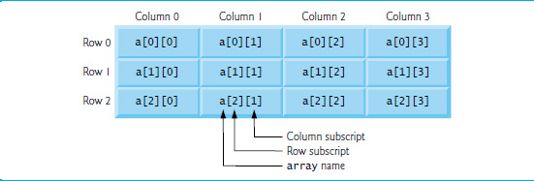
Figure 7.16 Two-Dimensional Array with Three Rows and Four Columns

Slide 79
Common Programming Error 7.5
Referencing a two-dimensional array element
incorrectly as
is an error. Actually, a[x, y] is treated as a[y], because C++ evaluates the expression x, y (containing a comma operator) simply as y (the last of the comma-separated expressions).

Slide 80
7.8 Multidimensional Arrays (2 of 4)
Figure 7.17 demonstrates initializing two-dimensional arrays in declarations.
In each array, the type of its elements is specified as
array<int, columns>
Each array contains as its elements three-element arrays of int values—the constant columns has the value 3.

Slide 81
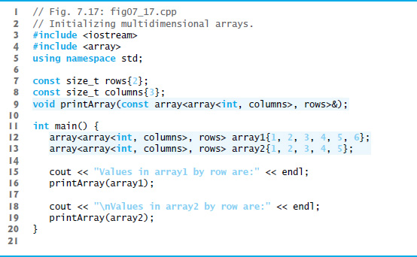
Figure 7.17 Initializing Multidimensional Arrays (1 of 2)

Slide 82
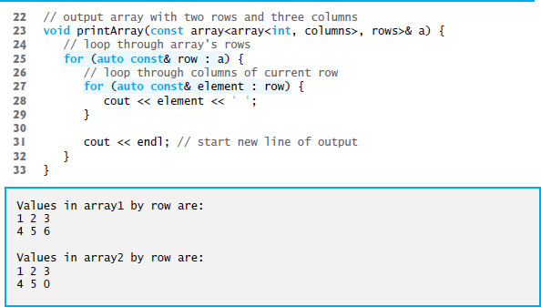
Figure 7.17 Initializing Multidimensional Arrays (2 of 2)

Slide 83
7.8 Multidimensional Arrays (3 of 4)
Nested Range-Based for Statements
To process the elements of a two-dimensional array, we use a nested loop in which the outer loop iterates through the rows and the inner loop iterates through the columns of a given row.
The C++11 auto keyword tells the compiler to infer (determine) a variable’s data type based on the variable’s initializer value.

Slide 84
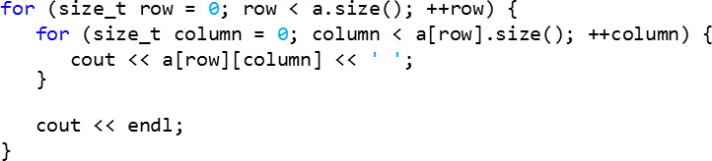
7.8 Multidimensional Arrays (4 of 4)
Nested Counter-Controlled for Statements
We could have implemented the nested loop with counter-controlled iteration as follows:

Slide 85
7.9 Case Study: Class GradeBook Using a Two-Dimensional Array
In most semesters, students take several exams.
Professors are likely to want to analyze grades across the entire semester, both for a single student and for the class as a whole.
Figure 7.18 shows the output that summarizes 10 students grades on three exams.
We store the grades as a two-dimensional array in an object of the next version of class GradeBook Figures 7.19–7.20.
Each row of the array represents a single student’s grades for the entire course, and each column represents all the grades the students earned for one particular exam.

Slide 86
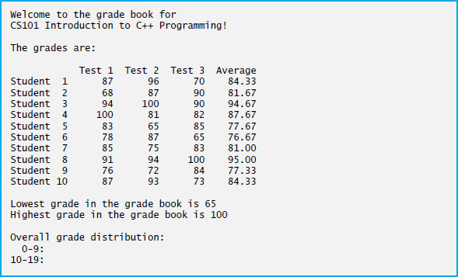
Figure 17.8 Output of GradeBook That Uses Two-Dimensional Arrays (1 of 2)

Slide 87
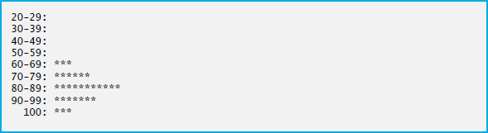
Figure 17.8 Output of GradeBook That Uses Two-Dimensional Arrays (2 of 2)

Slide 88
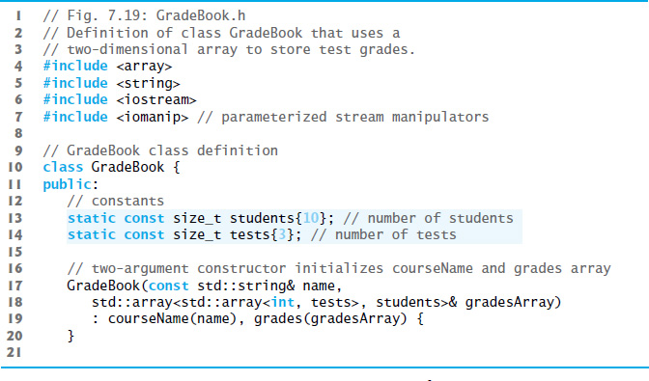
Figure 7.19 Definition of Class GradeBook That Uses a Two-Dimensional Array to Store Test Grades (1 of 10)

Slide 89
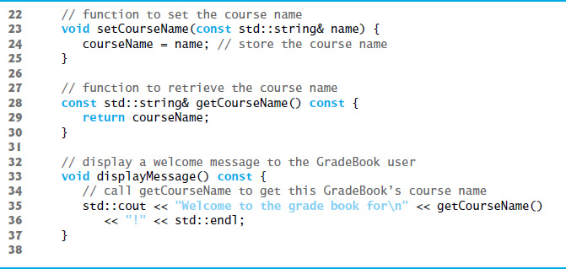
Figure 7.19 Definition of Class GradeBook That Uses a Two-Dimensional Array to Store Test Grades (2 of 10)

Slide 90
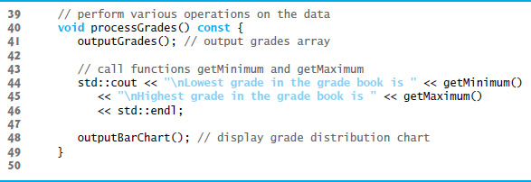
Figure 7.19 Definition of Class GradeBook That Uses a Two-Dimensional Array to Store Test Grades (3 of 10)

Slide 91
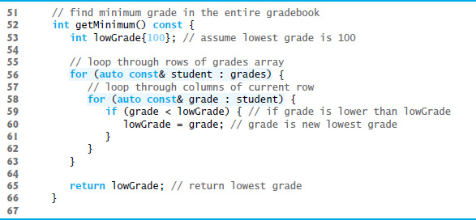
Figure 7.19 Definition of Class GradeBook That Uses a Two-Dimensional Array to Store Test Grades (4 of 10)

Slide 92
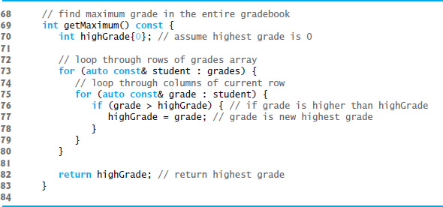
Figure 7.19 Definition of Class GradeBook That Uses a Two-Dimensional Array to Store Test Grades (5 of 10)

Slide 93
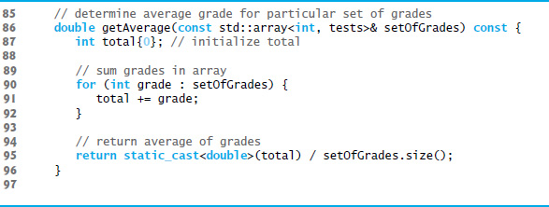
Figure 7.19 Definition of Class GradeBook That Uses a Two-Dimensional Array to Store Test Grades (6 of 10)

Slide 94
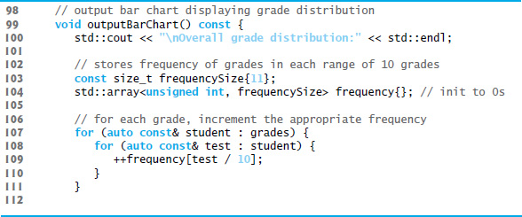
Figure 7.19 Definition of Class GradeBook That Uses a Two-Dimensional Array to Store Test Grades (7 of 10)

Slide 95
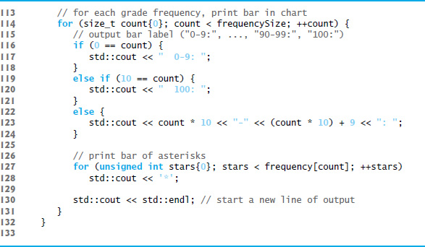
Figure 7.19 Definition of Class GradeBook That Uses a Two-Dimensional Array to Store Test Grades (8 of 10)

Slide 96

Figure 7.19 Definition of Class GradeBook That Uses a Two-Dimensional Array to Store Test Grades (9 of 10)

Slide 97

Figure 7.19 Definition of Class GradeBook That Uses a Two-Dimensional Array to Store Test Grades (10 of 10)

Slide 98

Figure 7.20 Creates a GradeBook Object Using a Two-Dimensional Array of Grades, Then Invokes Member Function ProcessGrades to Analyze Them (1 of 2)

Slide 99

Figure 7.20 Creates a GradeBook Object Using a Two-Dimensional Array of Grades, Then Invokes Member Function ProcessGrades to Analyze Them (2 of 2)

Slide 100
7.10 Introduction to C++ Standard Library Class Template Vector (1 of 8)
C++ Standard Library class template vector is similar to class template array, but also supports dynamic resizing.
Except for the features that modify a vector, the other features shown in Figure 7.21 also work for arrays.
Standard class template vector is defined in header <vector> (line 5) and belongs to namespace std.

Slide 101

Figure 7.21 Demonstrating C++ Standard Library Class Template Vector (1 of 7)

Slide 102

Figure 7.21 Demonstrating C++ Standard Library Class Template Vector (2 of 7)

Slide 103

Figure 7.21 Demonstrating C++ Standard Library Class Template Vector (3 of 7)

Slide 104

Figure 7.21 Demonstrating C++ Standard Library Class Template Vector (4 of 7)

Slide 105

Figure 7.21 Demonstrating C++ Standard Library Class Template Vector (5 of 7)

Slide 106

Figure 7.21 Demonstrating C++ Standard Library Class Template Vector (6 of 7)

Slide 107

Figure 7.21 Demonstrating C++ Standard Library Class Template Vector (7 of 7)

Slide 108
7.10 Introduction to C++ Standard Library Class Template Vector (2 of 8)
By default, all the elements of a vector object are set to 0.
vectors can be defined to store most data types.
vector member function size obtain the number of elements in the vector.
As with class template array, you can also do this using a counter-controlled loop and the subscript ([]) operator.

Slide 109
7.10 Introduction to C++ Standard Library Class Template Vector (3 of 8)
Notice that we used parentheses rather than braces to pass the size argument to each vector object’s constructor.
When creating a vector, if the braces contain one value of the vector’s element type, the braces are treated as a one-element initializer list, rather than a call to the constructor that sets the vector’s size.
The following declaration actually creates a one-element vector<int> containing the int value 7, not a 7-element vector
vector<int> integers1{7};

Slide 110
7.10 Introduction to C++ Standard Library Class Template Vector (4 of 8)
You can use the assignment (=) operator with vector objects.
As is the case with arrays, C++ is not required to perform bounds checking when vector elements are accessed with square brackets.
Standard class template vector provides bounds checking in its member function at (as does class template array).

Slide 111
7.10 Introduction to C++ Standard Library Class Template Vector (5 of 8)
An exception indicates a problem that occurs while a program executes.
The name “exception” suggests that the problem occurs infrequently.
Exception handling enables you to create fault-tolerant programs that can resolve (or handle) exceptions.
When a function detects a problem, such as an invalid array subscript or an invalid argument, it throws an exception—that is, an exception occurs.

Slide 112
7.10 Introduction to C++ Standard Library Class Template Vector (6 of 8)
To handle an exception, place any code that might throw an exception in a try statement.
The try block contains the code that might throw an exception, and the catch block contains the code that handles the exception if one occurs.
You can have many catch blocks to handle different types of exceptions that might be thrown in the corresponding try block.
The vector member function at provides bounds checking and throws an exception if its argument is an invalid subscript.
By default, this causes a C++ program to terminate.

Slide 113
Performance Tip 7.2
Catching an exception by reference increases performance by preventing the exception object from being copied when it’s caught. You’ll see in later chapters that catching by reference is also important when defining catch blocks that process related exception types.

Slide 114
7.10 Introduction to C++ Standard Library Class Template Vector (7 of 8)
Changing the Size of a vector
One of the key differences between a vector and an array is that a vector can dynamically grow and shrink as the number of elements it needs to accommodate varies.
To demonstrate this, line 88 shows the current size of integers3, line 89 calls the vector’s push_back member function to add a new element containing 1000 to the end of the vector and line 90 shows the new size of integers3.
Line 92 then displays integers3’s new contents.

Slide 115
7.10 Introduction to C++ Standard Library Class Template Vector (8 of 8)
C++ 11: List Initializing a vector
Many of the array examples in this chapter used list initializers to specify the initial array element values.
C++ 11 also allows this for vectors (and other C++ Standard Library data structures).

Slide 116

Copyright

